Slide 1


Natural Gas Engineering Project Presentation
By: Chaitanya Sangani

Slide 2
Problem Statements
1
2
Study the Variation in Operating flow rate with Reservoir Pressure and Depth
Study the Variation in Operating flow rate with Choke diameter and Pipe diameter

Slide 3


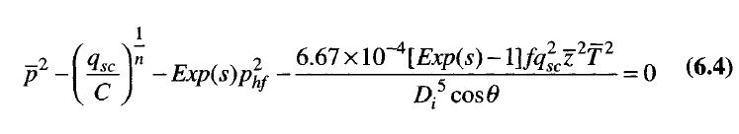
Problem Statement 1
Factor affecting Operating flow rate: Governing Equations
1. Theory
2. Simulation
3. Results
4. Analysis
TPR
IPR

Slide 4
Problem Statement 1
Simulation Method
2. Breakthrough time
3. Degradation
4. Exposure rate
1. Permeation
2. Simulation
3. Results
4. Analysis
1. Theory
MATLAB Code was written for the iteration of the equation by giving all the parameters
Fzero function was used for iterative solution of the Non linear equation

Slide 5
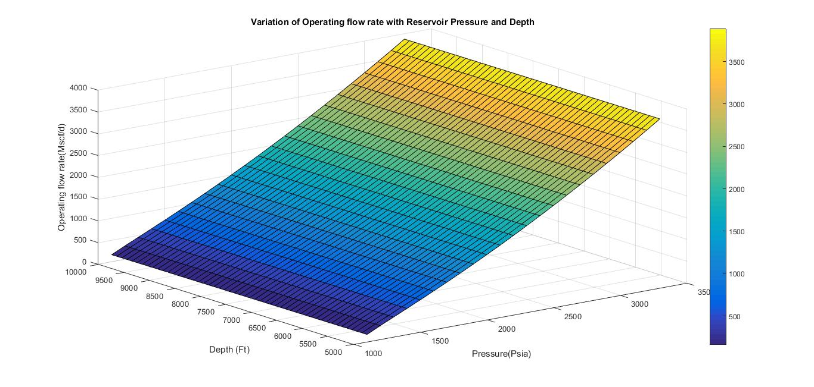
Problem Statement 1
Results
2. Breakthrough time
3. Degradation
4. Exposure rate
1. Permeation
2. Simulation
3. Results
4. Analysis
1. Theory

Slide 6
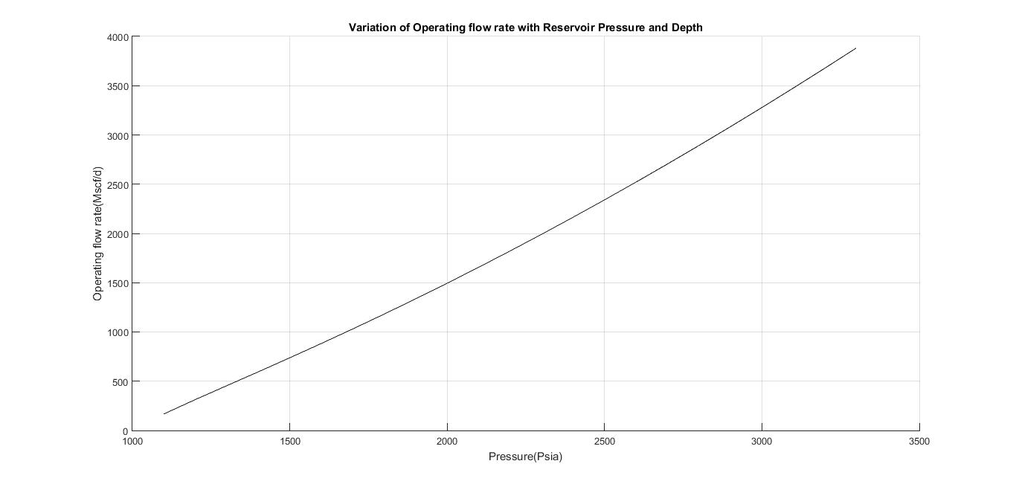
Problem Statement 1
Results
2. Breakthrough time
3. Degradation
4. Exposure rate
1. Permeation
2. Simulation
3. Results
4. Analysis
1. Theory

Slide 7
Problem Statement 1
Analysis
2. Breakthrough time
3. Degradation
4. Exposure rate
1. Permeation
2. Simulation
3. Results
4. Analysis
1. Theory
For given pressure, the flow rate was almost same for all the depths.
Change in operating pressure with reservoir pressure was almost linear

Slide 8
Problem Statement 2
Factor affecting Operating flow rate: Governing Equations
1. Theory
2. Simulation
3. Results
4. Analysis
IPR +TPR
CPR

Slide 9
Problem Statement 2
Simulation Method
2. Breakthrough time
3. Degradation
4. Exposure rate
1. Permeation
2. Simulation
3. Results
4. Analysis
1. Theory
MATLAB Code was written for the iteration of the equation by giving all the parameters
Fzero function was used for iterative solution of the Non linear equation

Slide 10
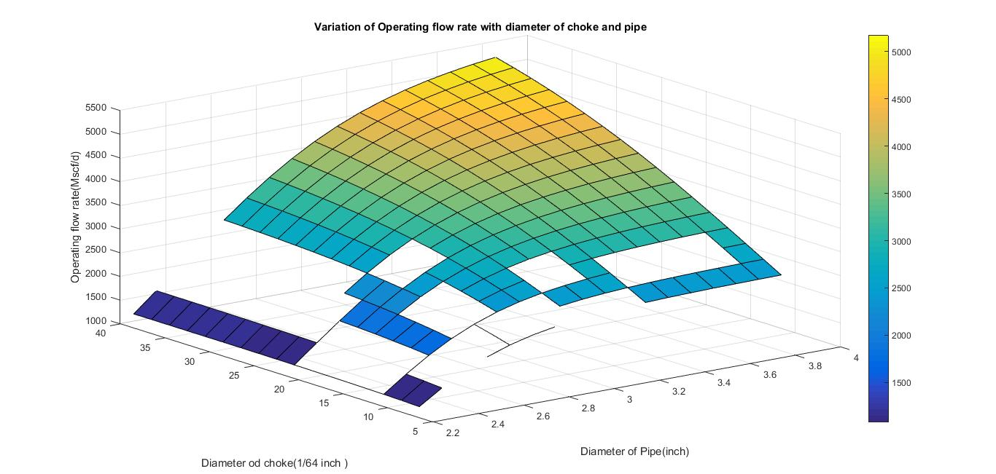
Problem Statement 1
Results
2. Breakthrough time
3. Degradation
4. Exposure rate
2. Simulation
3. Results
1. Theory
3. Results
4. Analysis

Slide 11
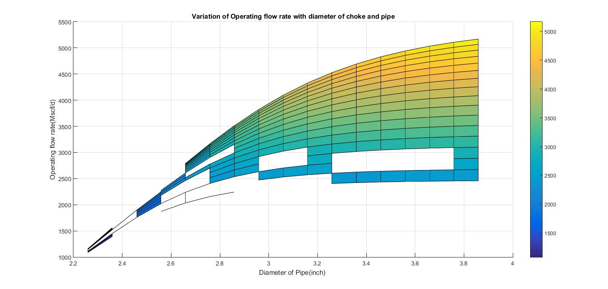
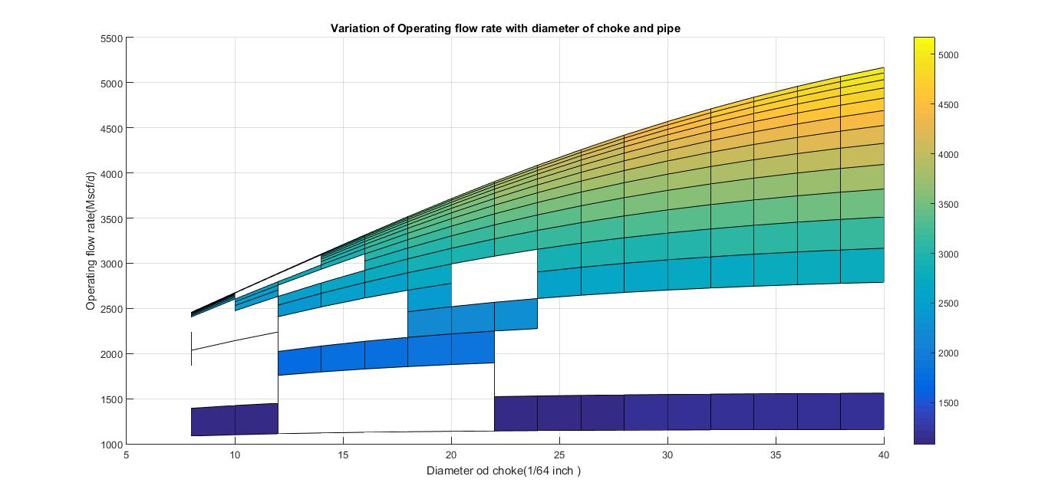
Problem Statement 2
Results
2. Breakthrough time
3. Degradation
4. Exposure rate
2. Simulation
3. Results
1. Theory
3. Results
4. Analysis

Slide 12
Problem Statement 2
Results
2. Breakthrough time
3. Degradation
4. Exposure rate
2. Simulation
3. Results
1. Theory
3. Results
4. Analysis
The operating flow rate increased with increase in sizes of both choke and pipe diameter.
The flow rate was more sensitive to change in pipe diameter than the choke diameter.

Slide 13


